Slide 1
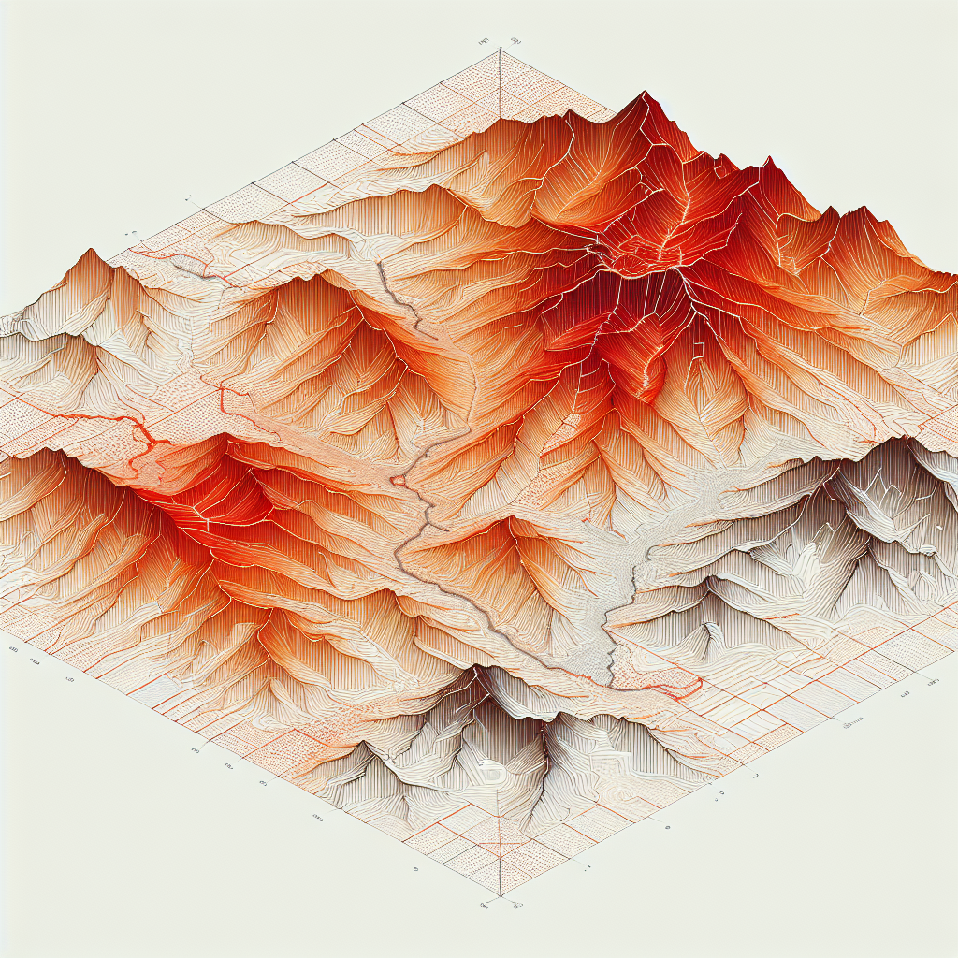
Climate Risk Hotspots
Rising temperatures shifting suitable altitude (~300 m per °C)
Rainfall variability and drought stress
Pest/disease pressure (coffee leaf rust, berry borer)
Region: Central America (1,000–1,600 m)
Risks: Rust resurgence, drought; suitability loss by 2050
Region: Ethiopia highlands
Risks: Suitability migration upslope; biodiversity trade-offs
Region: Brazil (Minas Gerais)
Risks: Heat waves, irregular rainfall; irrigation demand rising
Region: Vietnam Central Highlands
Risks: Water scarcity; robusta heat tolerance tested
Map spec:
Type: hexbin risk overlay
Risk index: 1 (low) to 5 (very high)
Scenario: 2030 & 2050 overlays (SSP2-4.5)
Layers:
- Temperature anomaly
- Water deficit
- Pest pressure proxy
Chart spec:
Type: line
Title: Suitability vs Altitude
Series:
- 2020
- 2030
- 2050
X axis: Altitude (m)
Y axis: Suitability score (0–1)

